Slide 1
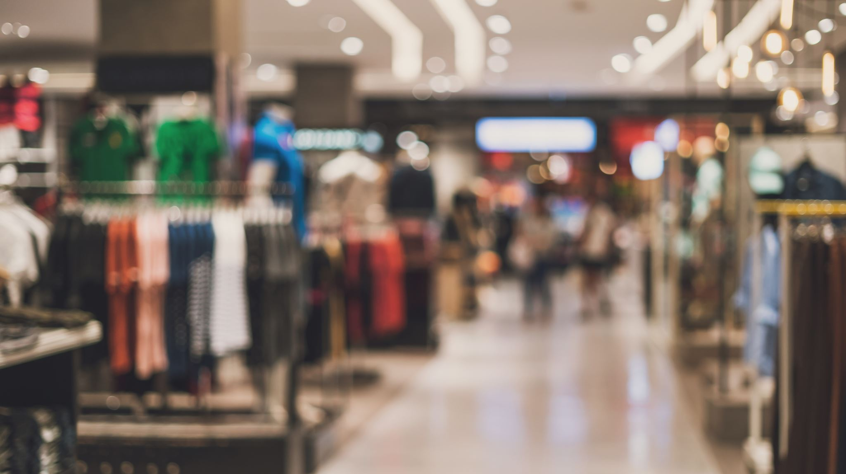
Online Super Shop Management System
Presented BY:
Md. Taofick Mahmoodur Rahaman
ID: 221-35-847
MD Mubtasim Fuad Khan
ID: 221-35-883
Md. Rakib Hasan
ID: 221-35-964

Slide 2
Software Requirement Specification
FR-01 | User Registration
Description | Users can register for an account by providing necessary information, including personal details and contact information.
Stakeholders | Customers, Shop Managers
FR-02 | Product Management
Description | This module enables Shop Managers to manage the inventory of products available in the online super shop. Shop Managers can add, edit, and remove product listings.
Stakeholders | Shop Managers
FR-03 | Browsing Products
Description | Users should be able to browse products based on various criteria, such as category, price range, and popularity.
Stakeholders | Customers

Slide 3
Software Requirement Specification
FR-04 | Shopping Cart
Description | A Shopping Cart module allows Customers to review and modify the items in their cart before proceeding to checkout.
Stakeholders | Customers
FR-05 | Search and Filter
Description | Users can search for products based on keywords, categories, and other filters for an enhanced shopping experience.
Stakeholders | Customers
FR-06 | Order Placement
Description | Customers can browse the product catalog, add items to the shopping cart, and place orders.
Stakeholders | Customers

Slide 4
Software Requirement Specification
FR-07 | Payment Integration
Description | The system must integrate a secure payment gateway to facilitate online transactions. Accepted payment methods should include credit/debit cards, mobile wallets, and other common forms of digital payment or Cash on Delivery.
Stakeholders | Shop Manager, Customers
FR-08 | Product Reviews and Ratings
Description | Customers can submit reviews and ratings for products, contributing to the overall feedback and reputation of items.
Stakeholders | Customers
FR-09 | Notifications
Description | The system shall send notifications to Customers regarding order updates, promotions, and other relevant information.
Stakeholders | Customers

Slide 5
Software Requirement Specification
FR-10 | Order Cancellation
Description | This feature allows Customers to cancel their orders within a predefined time frame after placing the order. The system should automatically update inventory levels and notify Shop Managers and Delivery Man of the cancellation.
Stakeholders | Customers, Shop Managers
FR-11 | Delivery Tracking
Description | The system should provide real-time GPS tracking for delivery men to optimize routes and provide accurate delivery estimates.
Stakeholders | Customers, Shop Managers

Slide 6
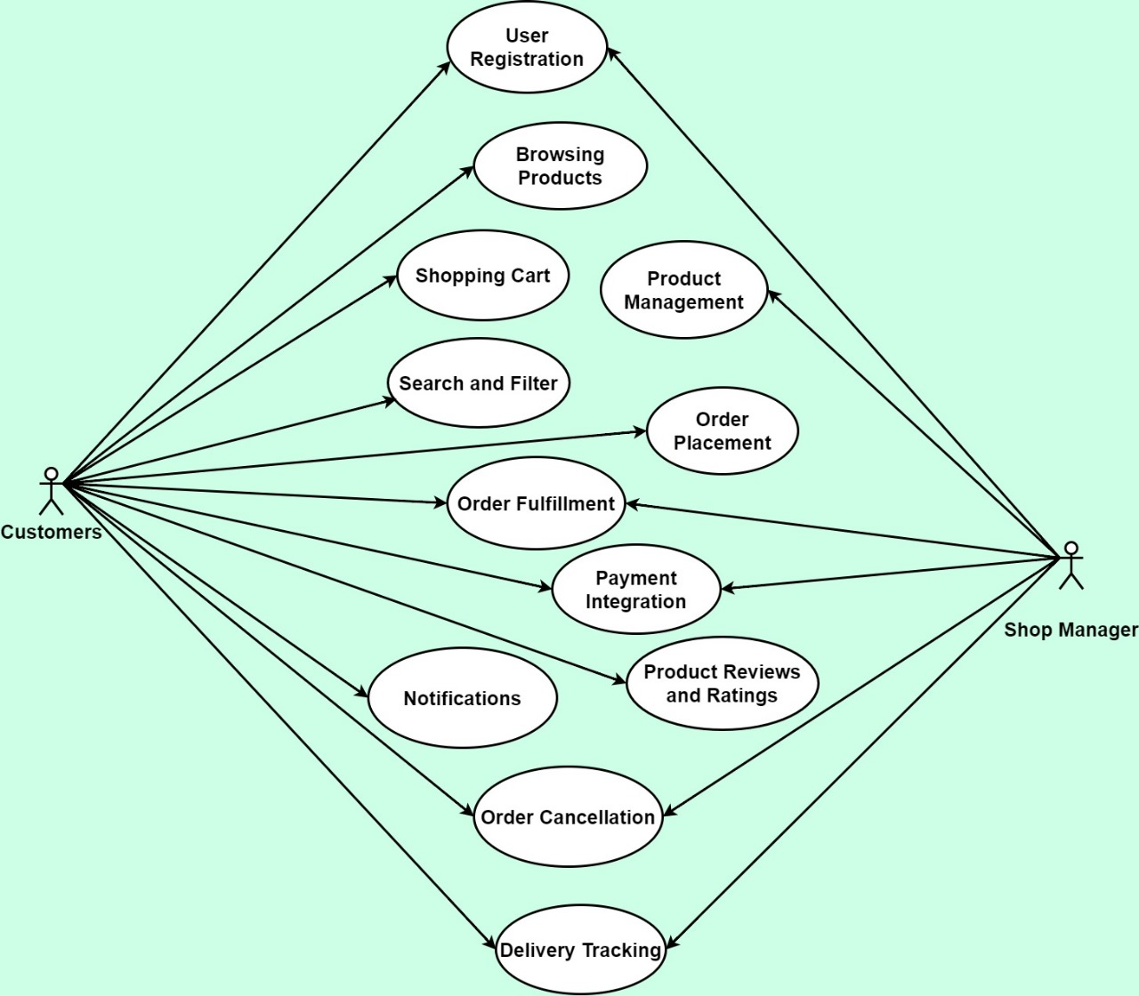
Use Case Diagram

Slide 7
Case Description-01: User Registration
Use Case | User Registration
Goal | Allow users to register in the system.
Preconditions | The user is not registered in the system.
Success End Condition | The user successfully registers and gains access to the system.
Failed End Condition | Registration is unsuccessful.
Primary Actors: Secondary Actors: | Customers
Trigger | The user initiates the registration process.
Description / Main Success Scenario | Step | Action
 | 1 | The user accesses the registration page.
 | 2 | The user provides required information, including name, email address, and password.
 | 3 | The system validates the entered information.
 | 4 | If validation is successful, the system creates a new user account.
 | 5 | The system sends a confirmation email to the user for account verification.
 | 6 | The user clicks the verification link in the email.
 | 7 | The system activates the user account.
Alternative Flows | If the user provides invalid information, the system prompts for corrections.
Quality Requirements | The registration process should be completed within two minutes.

Slide 8
Case Description-02: Product Management
Use Case | Product Management
Goal | Enable shop managers to manage product information.
Preconditions | Shop Manager is logged into the system.
Success End Condition | Product information is successfully updated in the system.
Failed End Condition | Product information is not updated.
Primary Actors: Secondary Actors: | Shop Manager
Trigger | Shop Manager accesses the product management interface.
Description / Main Success Scenario | Step | Action
 | 1 | The Shop Manager accesses the product management interface..
 | 2 | The system displays a list of existing products.
 | 3 | The Shop Manager can add new products, edit existing ones, or remove products.
 | 4 | The Shop Manager updates product details, such as name, description, and price.
 | 5 | The system validates and saves the changes.
Alternative Flows | If the Shop Manager encounters an issue, the system provides error messages.
Quality Requirements | Product information updates should be reflected in real-time.

Slide 9
Case Description-03: Browsing Products
Use Case | Browsing Products
Goal | Allow users to browse and view product information.
Preconditions | User is on the home page or product catalog.
Success End Condition | User has explored product information on the platform.
Failed End Condition | User is unable to access product information.
Primary Actors: Secondary Actors: | Customers
Trigger | User navigates to the product catalog.
Description / Main Success Scenario | Step | Action
 | 1 | The user navigates through product categories or featured items.
 | 2 | The system displays a grid of products with basic information.
 | 3 | The user clicks on a product for detailed information.
 | 4 | The system displays detailed product information, including images, description, and price.
Alternative Flows | The user can refine the product list based on search criteria.
Quality Requirements | Product information should be loaded within three seconds.

Slide 10
Case Description-04: Shopping Cart
Use Case | Shopping Cart
Goal | Enable users to add products to a shopping cart and proceed to checkout.
Preconditions | User is logged in and has selected products for purchase.
Success End Condition | Products are in the user's shopping cart for order placement.
Failed End Condition | Products are not added to the shopping cart.
Primary Actors: Secondary Actors: | Customers
Trigger | User proceeds to checkout from the shopping cart.
Description / Main Success Scenario | Step | Action
 | 1 | The user adds products to the shopping cart.
 | 2 | The system updates the shopping cart total.
 | 3 | The user can view and manage the items in the shopping cart.
 | 4 | The user proceeds to checkout.
Alternative Flows | The user can refine the product list based on search criteria.
Quality Requirements | Product information should be loaded within three seconds.

Slide 11
Case Description-05: Search and Filter
Use Case | Search and Filter
Goal | Allow users to search for products and apply filters.
Preconditions | User is on the product catalog or search page.
Success End Condition | User has a narrowed-down set of products based on search criteria.
Failed End Condition | Search and filtering options are not effective.
Primary Actors: Secondary Actors: | Customers
Trigger | User enters search terms or applies filters.
Description / Main Success Scenario | Step | Action
 | 1 | The user enters search terms or applies filters.
 | 2 | The system updates the product grid based on search criteria.
 | 3 | The user can further refine search results or reset filters.
Alternative Flows | The system suggests autocomplete options based on entered search terms.
Quality Requirements | Search results should be displayed within two seconds.

Slide 12
Case Description-06: Order Placement
Use Case | Order Placement
Goal | Enable users to place an order for selected products.
Preconditions | User has selected products and is ready to make a purchase.
Success End Condition | Order is successfully placed, and the user receives an order confirmation.
Failed End Condition | Order placement is unsuccessful.
Primary Actors: Secondary Actors: | Customers
Trigger | User confirms the order details.
Description / Main Success Scenario | Step | Action
 | 1 | The user proceeds to checkout from the shopping cart.
 | 2 | The system displays the order summary, including selected items and total cost.
 | 3 | The user confirms the order details.
 | 4 | The system prompts the user to choose a delivery address and payment method.
 | 5 | The user provides necessary information for delivery and selects a payment method.
 | 6 | The system validates the information and processes the order.
Alternative Flows | If the user encounters issues during payment, the system provides guidance.
Quality Requirements | Order processing should take no longer than five seconds.

Slide 13
Case Description-07: Payment Integration
Use Case | Payment Integration
Goal | Integrate secure payment processing for user transactions.
Preconditions | User is at the checkout stage, and payment information is required.
Success End Condition | Payment is successfully processed, and the order is confirmed.
Failed End Condition | Payment processing is unsuccessful, and the order is not confirmed.
Primary Actors: Secondary Actors: | Customers
Trigger | User selects a payment method during the checkout process.
Description / Main Success Scenario | Step | Action
 | 1 | The user selects a payment method during the checkout process.
 | 2 | The system redirects the user to the chosen payment gateway.
 | 3 | The user enters payment details and confirms the transaction.
 | 4 | The payment gateway processes the transaction and sends a confirmation to the system.
 | 5 | The system updates the order status to "Paid."
Alternative Flows | If payment authorization fails, the system prompts the user to retry or choose an alternative method.
Quality Requirements | Payment processing should take no longer than ten seconds.

Slide 14
Case Description-08: Product Reviews and Ratings
Use Case | Product Reviews and Ratings
Goal | Allow registered customers to submit reviews and ratings for products.
Preconditions | User has purchased a product.
Success End Condition | Product has updated reviews and ratings.
Failed End Condition | Product reviews and ratings are not updated.
Primary Actors: Secondary Actors: | Customers
Trigger | User accesses the product details page.
Description / Main Success Scenario | Step | Action
 | 1 | The user accesses the product details page.
 | 2 | The system displays options to leave a review and provide a rating.
 | 3 | The user submits a review and assigns a rating to the product.
 | 4 | The system updates the product's overall rating and displays the review.
Alternative Flows | If the user decides not to submit a review, the system retains the previous ratings.
Quality Requirements | Reviews and ratings should be processed and updated in real-time.

Slide 15
Case Description-09: Notifications
Use Case | Notifications
Goal | Keep users informed about important events and updates.
Preconditions | Relevant events or actions trigger notifications.
Success End Condition | Users receive timely notifications about important events.
Failed End Condition | Users do not receive notifications.
Primary Actors: Secondary Actors: | Customers Shop Manager
Trigger | System generates notifications for order updates, promotions, or other relevant information.
Description / Main Success Scenario | Step | Action
 | 1 | The system generates notifications for order updates, promotions, or other relevant information.
 | 2 | Notifications are sent to the respective users via email, in-app messages, or push notifications.
 | 3 | Users can view and manage notifications in their account settings.
Alternative Flows | Users can customize their notification preferences in the system settings.
Quality Requirements | Notifications should be delivered within one minute of the triggering event.

Slide 16
Case Description-10: Order Cancellation
Use Case | Order Cancellation
Goal | Enable customers or Shop Manager to cancel orders within a specified timeframe and ensure inventory and financial adjustments are handled efficiently.
Preconditions | Customer is logged into their account, and the order is within the cancellable timeframe.
Success End Condition | The order is successfully canceled, inventory is updated, and a refund is initiated if applicable.he user successfully registers and gains access to the system.
Failed End Condition | The order remains active, inventory and financial records are unchanged.
Primary Actors: Secondary Actors: | Customers Shop Manager
Trigger | Customer initiates the cancellation process for an order.
Description / Main Success Scenario | Step | Action
 | 1 | Customer accesses their order history.
 | 2 | System displays list of recent orders with options.
 | 3 | Customer selects cancellation for an eligible order.
 | 4 | System asks for confirmation.
 | 5 | Customer confirms.
 | 6 | System checks eligibility and updates status.
 | 7 | Inventory adjusted; refund initiated.
 | 8 | Customer receives confirmation.
Alternative Flows | a | Order not in cancellable timeframe - system informs customer.
 | b | Product type not cancellable - customer notified.
 | c | Technical issue with adjustments - Shop Manager notified.
Quality Requirements | Simple and intuitive cancellation process Real-time processing of inventory updates and refunds Clear feedback to customer during process Security measures to prevent fraud

Slide 17
Case Description-11: Delivery Tracking
Use Case | Delivery Tracking
Goal | Allow users to track the real-time status of their deliveries.
Preconditions | Order is in the "Out for Delivery" status.
Success End Condition | Users can track the real-time status of their deliveries.
Failed End Condition | Users cannot track the delivery status.
Primary Actors: Secondary Actors: | Customer Shop Manager
Trigger | Order is in the "Out for Delivery" status.
Description / Main Success Scenario | Step | Action
 | 1 | The system provides a real-time tracking interface for the registered customer.
 | 2 | The Delivery Man updates the delivery status upon successful completion.
Alternative Flows | If the delivery is delayed, the system provides updated estimated delivery times.
Quality Requirements | Delivery status updates should be real-time.

Slide 18
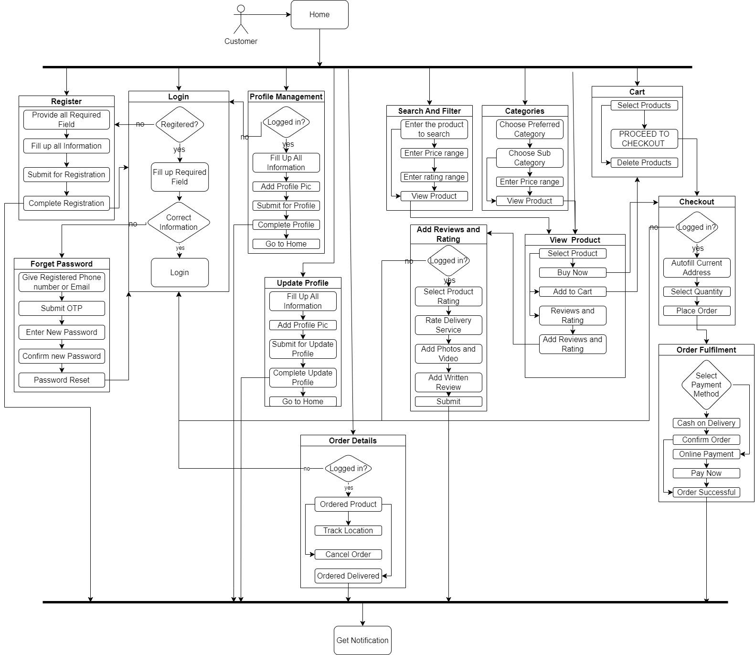
Block Diagram-1: Customer

Slide 19
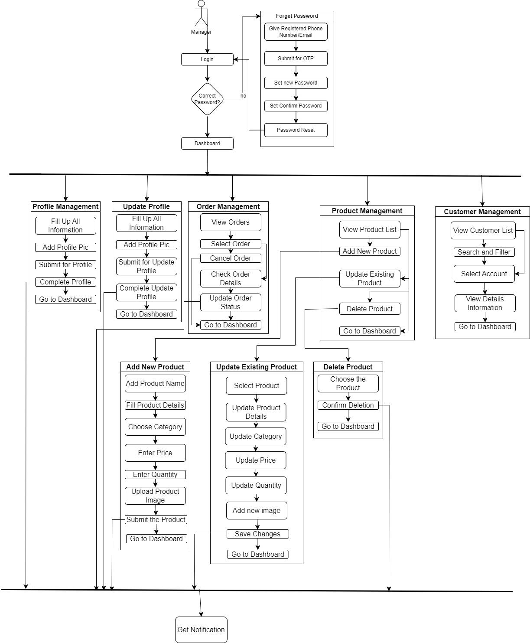
Block Diagram-2: Manager

Slide 20
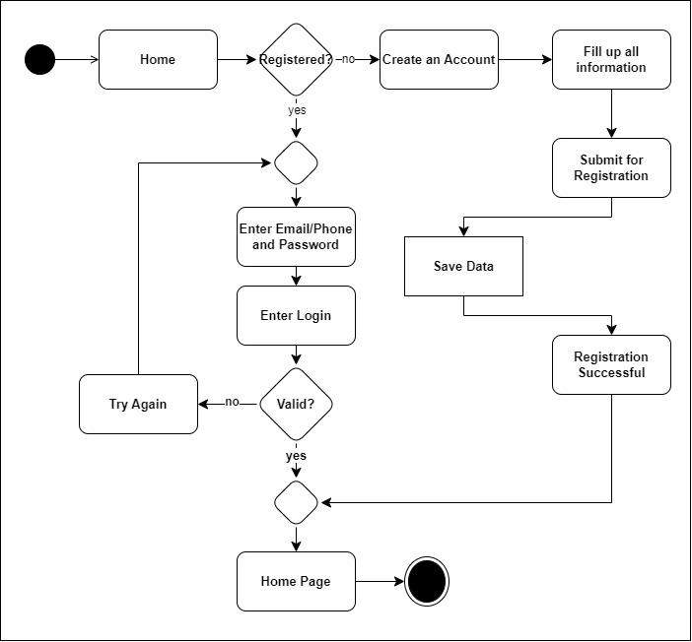
Activity Diagram-1: User Registration and Login

Slide 21
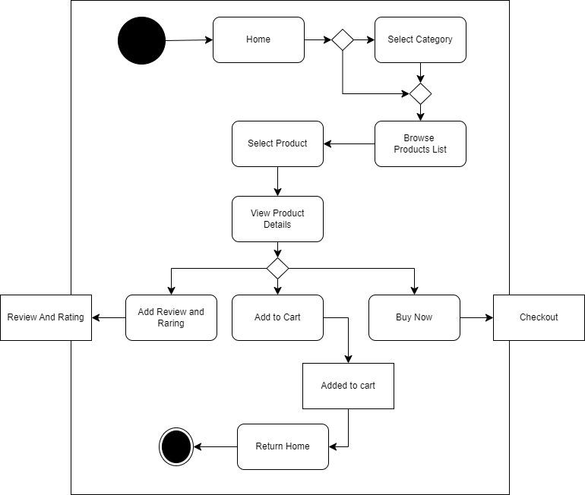
Activity Diagram-2: Browsing and View Product

Slide 22
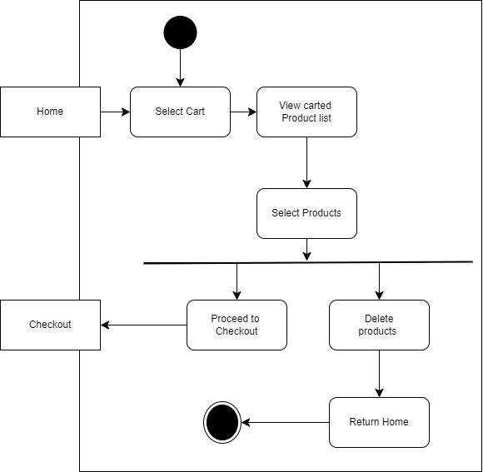
Activity Diagram-3: Shopping Cart

Slide 23
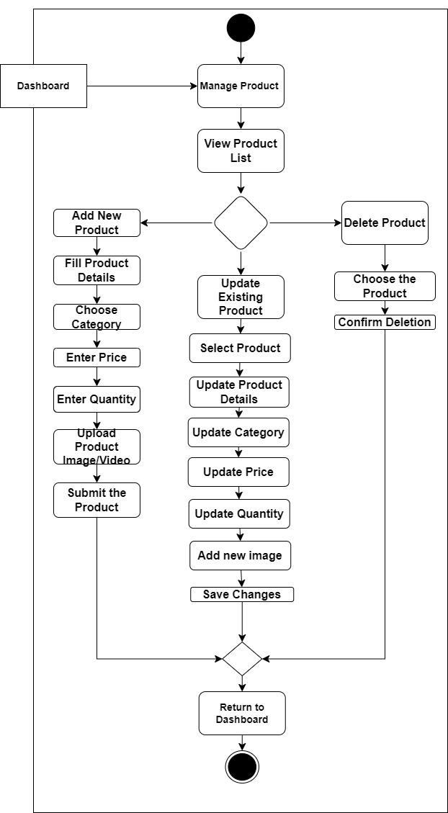
Activity Diagram-4: Product Management

Slide 24
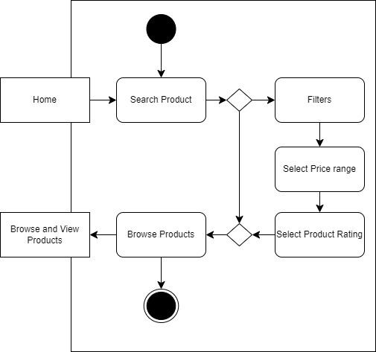
Activity Diagram-5: Search and Filter

Slide 25
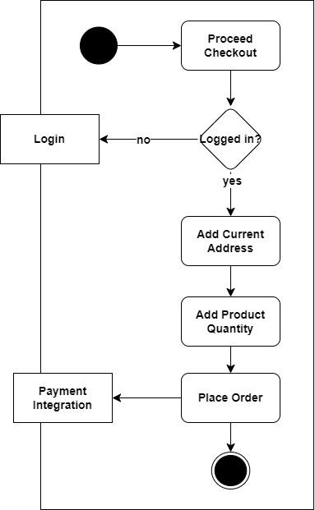
Activity Diagram-6: Order Placement

Slide 26
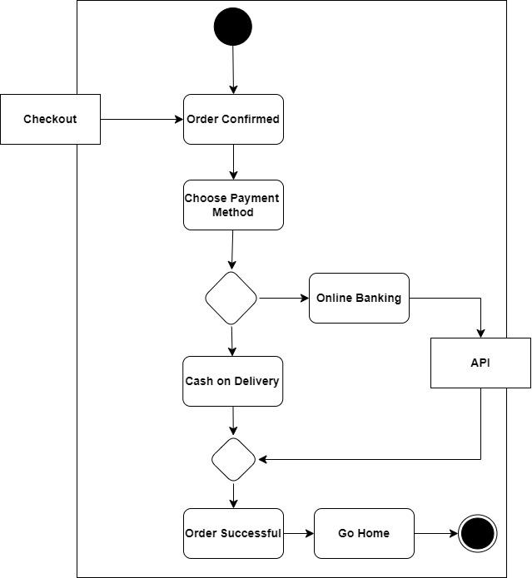
Activity Diagram-7: Payment Integration

Slide 27
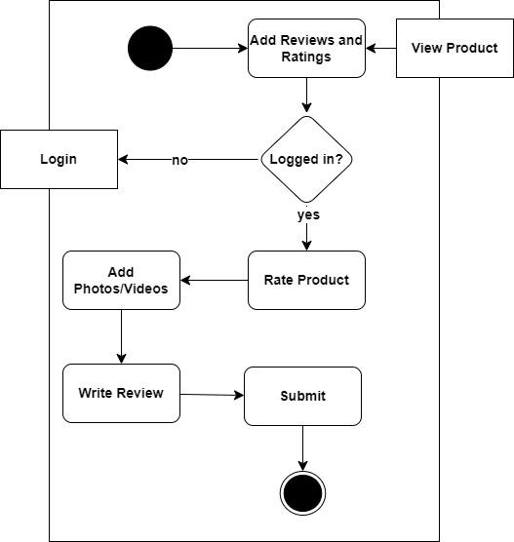
Activity Diagram-8: Product Reviews and Ratings

Slide 28
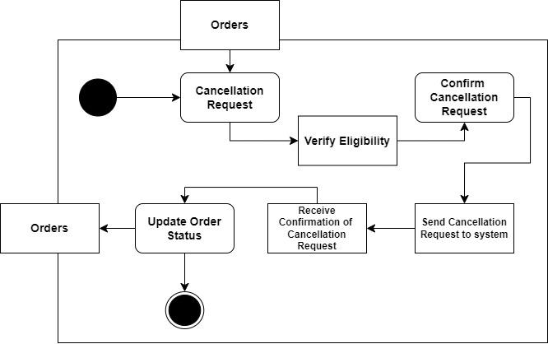
Activity Diagram-9: Order Cancellation

Slide 29
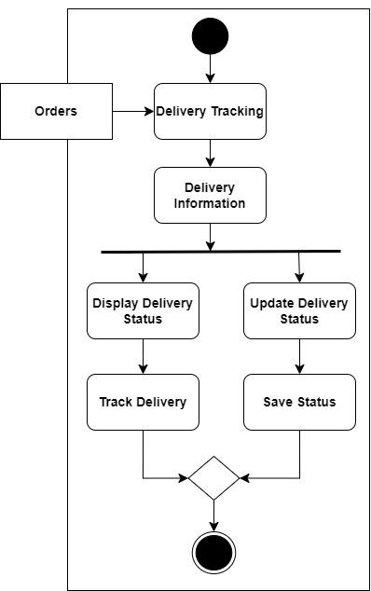
Activity Diagram-10: Delivery Tracking

Slide 30
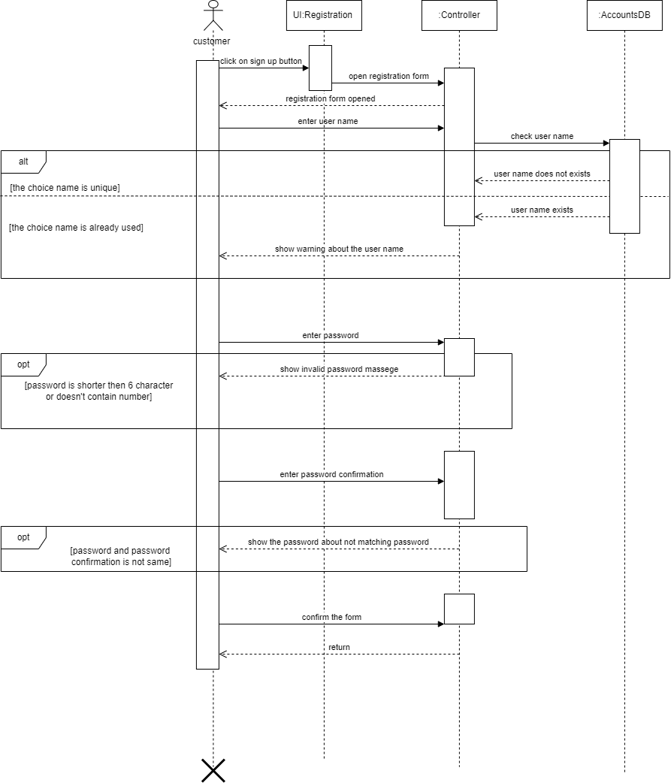
Sequence Diagram-1: User Registration

Slide 31
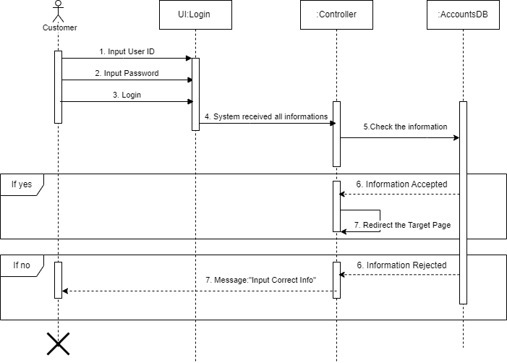
Sequence Diagram-2: User Login

Slide 32
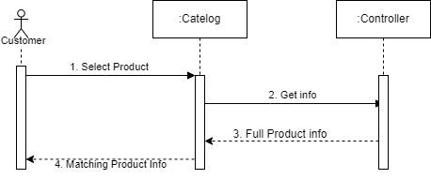
Sequence Diagram-3: View Product

Slide 33
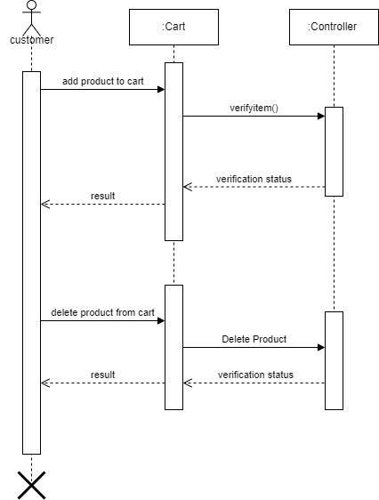
Sequence Diagram-4: Shopping Cart
o

Slide 34
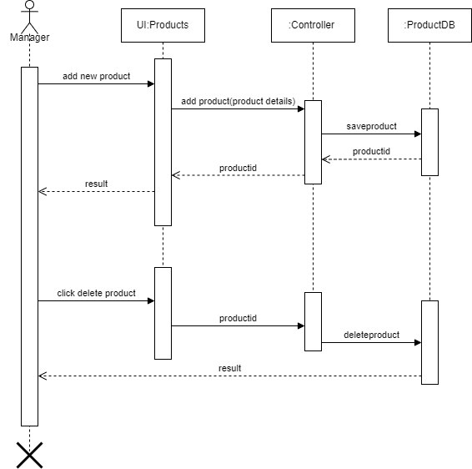
Sequence Diagram-5: Product Management

Slide 35
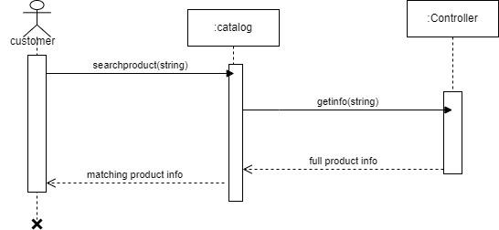
Sequence Diagram-6: Search Product

Slide 36
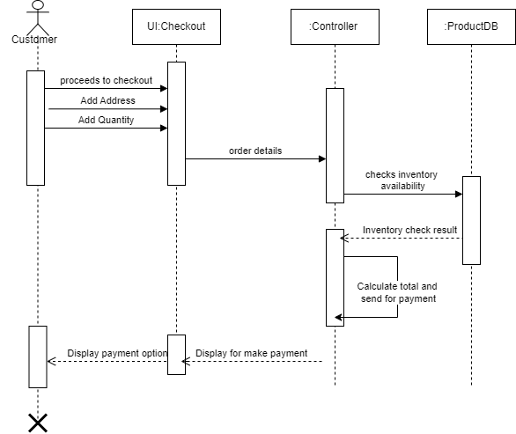
Sequence Diagram-7: Order Placement

Slide 37
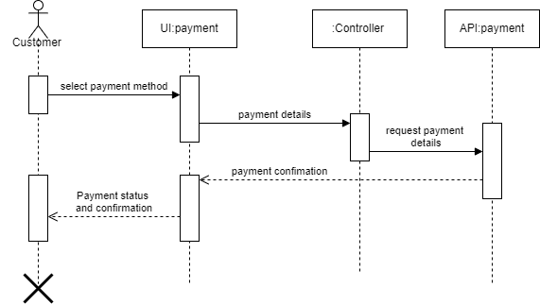
Sequence Diagram-8: Payment Integration

Slide 38
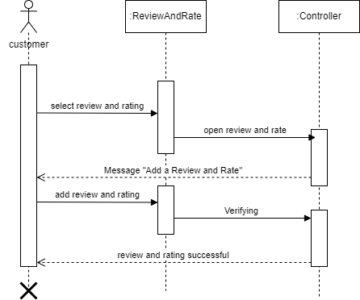
Sequence Diagram-9: Product Reviews and Ratings

Slide 39
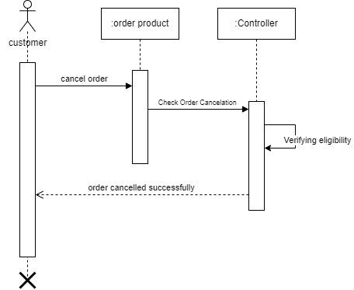
Sequence Diagram-10: Order Cancellation

Slide 40
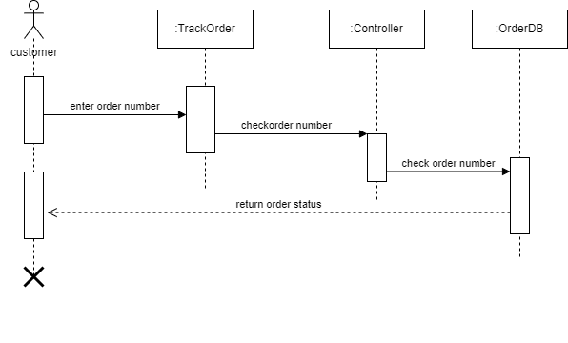
Sequence Diagram-11: Delivery Tracking

Slide 41
Thank You
Any Question?

